Slide 1



IPL CRUNCH '26
Uncovering the Hidden DNA of T20 Cricket
Moving beyond raw scores to discover the actual statistical drivers of
winning through ball-by-ball analysis of 280,000+ IPL deliveries from 2008 to 2026.
Presented by: Krishna Agrawal

Slide 2
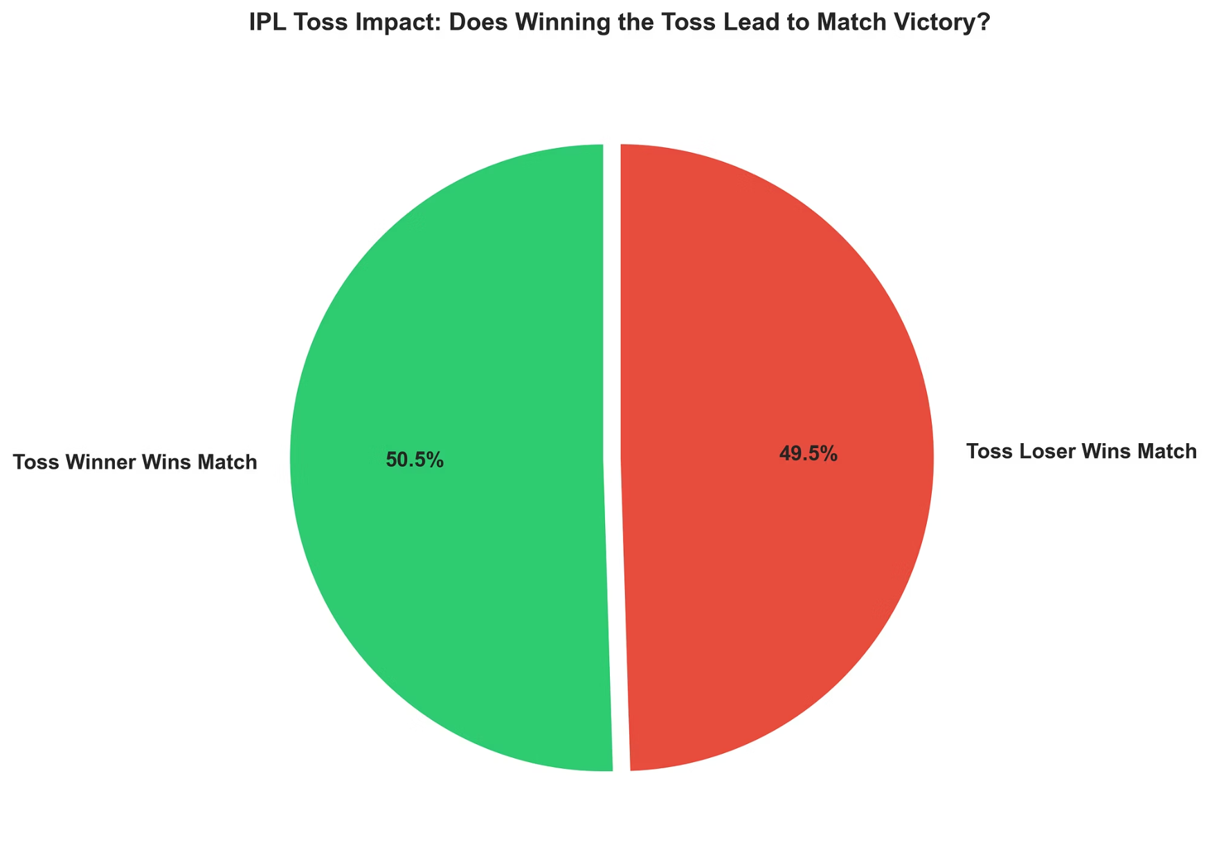

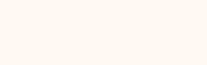
MANDATORY QUESTION 1
Myth-Busting the Coin Toss
Does winning the toss actually matter?
Across 1218 Matches, the toss is highly overrated — historical outcomes show an almost perfectly even split.
Toss Winners Win
50.5% of matches
Toss Losers Win
49.5% of matches
The gap is statistically negligible. Winning the coin toss provides no meaningful competitive advantage in the IPL.

Slide 3
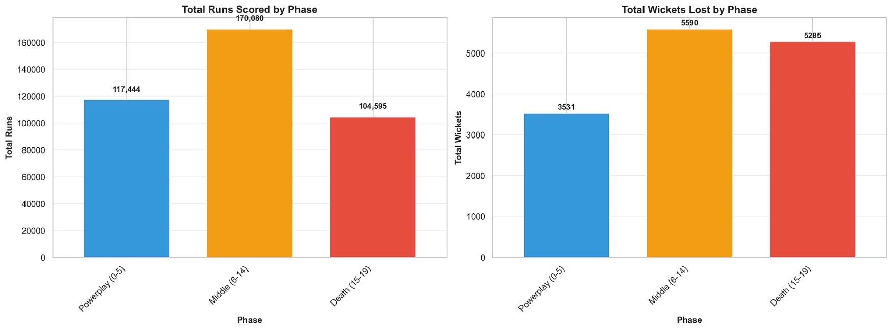
MANDATORY QUESTION 2
Where the Game Is Actually Played
The match splits into three phases: Powerplay (0–5), Middle Overs (6–14), and Death Overs (15–19).
The Middle Overs dominate both runs scored and wickets lost making them the true pivot point of every IPL match.
🏏 Powerplay (0–5)
Explosive starts and limited wickets lost, Sets the tone.
⚡ Middle Overs (6–14)
170K+ runs and 5.5K+ wickets. The true battleground.
💥 Death Overs (15–19)
High-risk finishing phase. Surviving the middle sets this up.

Slide 4
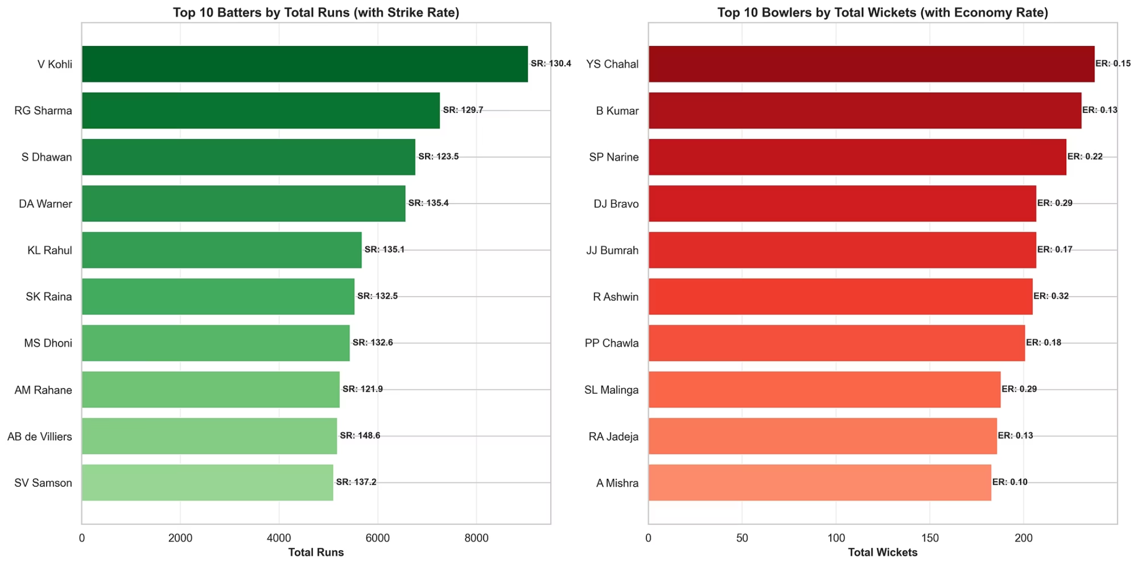
MANDATORY QUESTION 3
MVP Metrics: Volume vs. Efficiency
Total Runs tell one story, Strike rate and economy reveal another. The elite performers combine both.
Top Batters
Virat Kohli leads in raw run volume. AB de Villiers (148.6 SR) defines maximum impact per delivery.
Top Bowlers
Yuzvendra Chahal and Bhuvneshwar Kumar lead the pack, combining high wicket volume with elite economy rates across all IPL seasons.

Slide 5
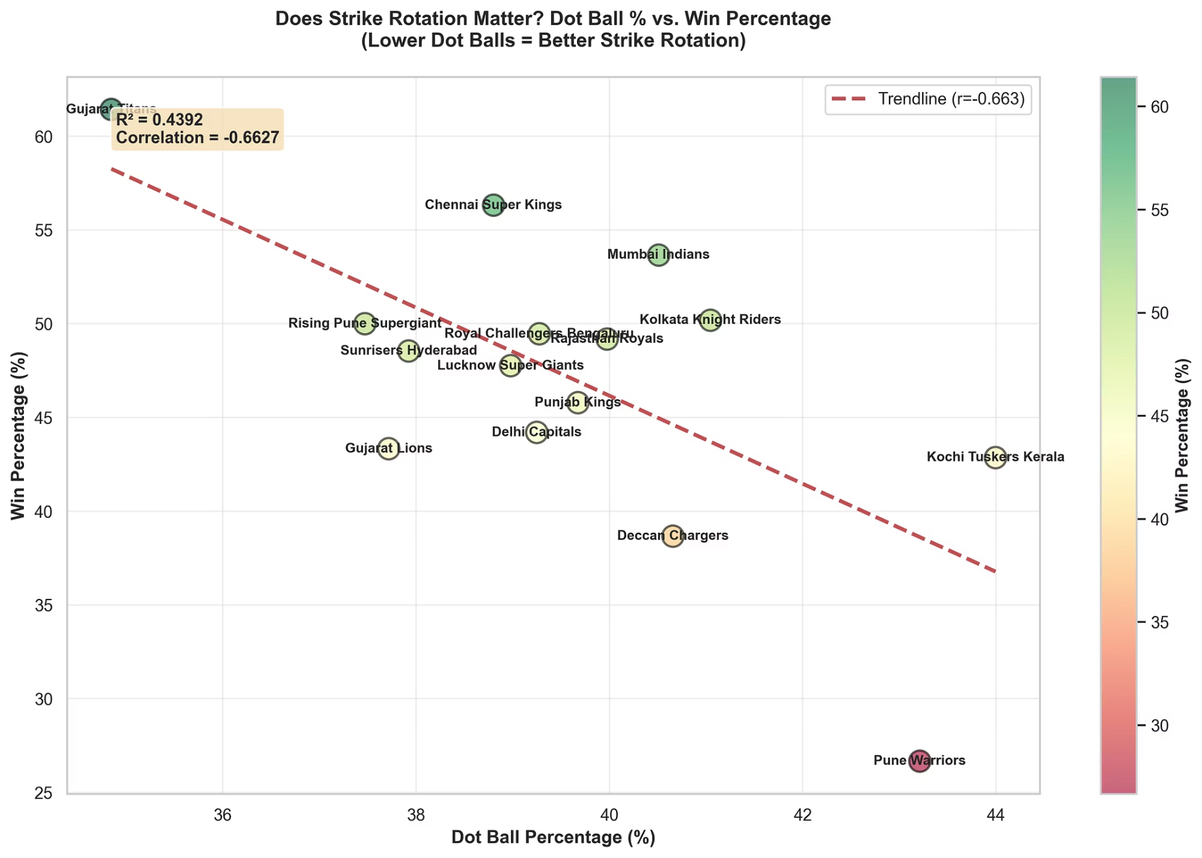

THE SECRET INSIGHT
The Hidden Key to Winning: Strike Rotation
The Myth -
T20 is won by hitting the most boundaries fours and sixes.
More explosive power = more wins.
The Reality -
Minimizing Dot Balls is a stronger predictor of win percentage.
Teams like CSK and GT with lower dot ball percentages consistently sit at the top of the table.
Strike rotation, not just boundary hitting, is the hidden statistical driver of IPL success.

Slide 6
CONCLUSION
Thank You
This analysis processed 280,000+ ball-by-ball records to prove that data reveals the true DNA of T20 cricket.
🌐 Live Dashboard
📂 GitHub Repository
Deployed on Vercel with real-time data processing and interactive visualizations.
Full source code, data pipeline, and documentation available for review.
ipl-neon-pi.vercel.app
View Repository →
🎯 Key Findings
Toss is irrelevant. Middle Overs decide matches. Strike rotation beats boundaries.

